Slide 1
EasyPP and EasyEOI
Emelie Ekenstedt and Max Maupoix
Notes:
EasyPP helps your client and you to produce and submit all six types of Partnership Profiles (PPs): Business Offers (BOs), Business Requests (BRs), Technology Offers (TOs), Technology Requests (TRs), Research & Development Request (RDRs), and Short Requests (SRs). You work with your client in the same document and PPs are submitted directly to EEN's database (POD) without any cut and paste. Clients don't need a password or to be registered.
EasyEOI will allow you to edit and send Expression of Interests (EOIs) to your clients who easily can register if they accept or reject it and how they would like to proceed. Likewise, a summary of accepted EOIs can be sent to the client to update collaboration status.

Slide 2
EasyPP
Write a profile together with you client
Submit it to Merlin

Slide 3
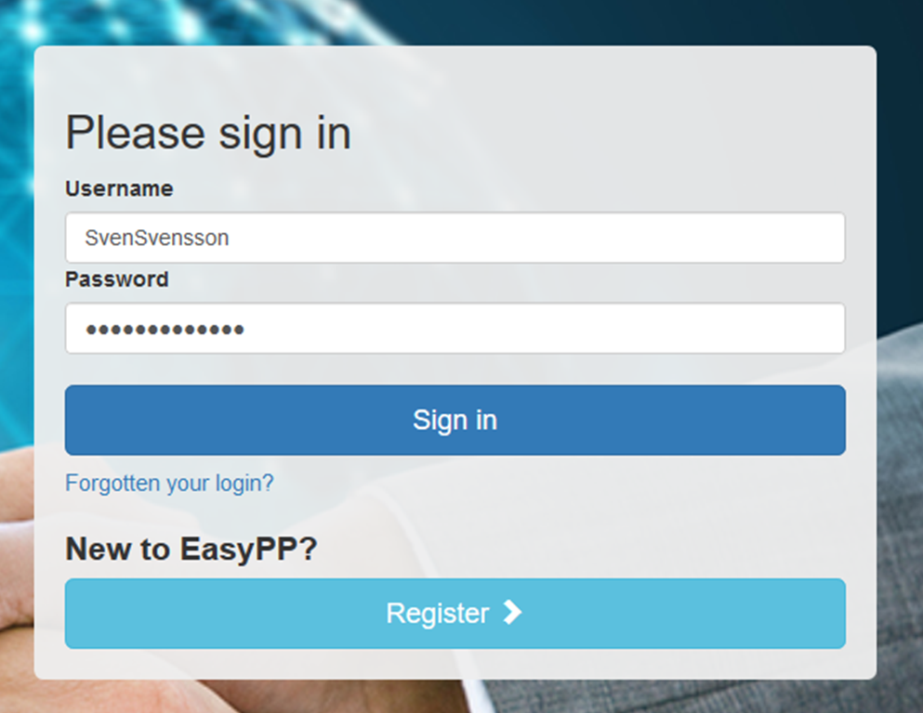
Login: www.EasyPP.eu

Slide 4
Create a new PP

Slide 5
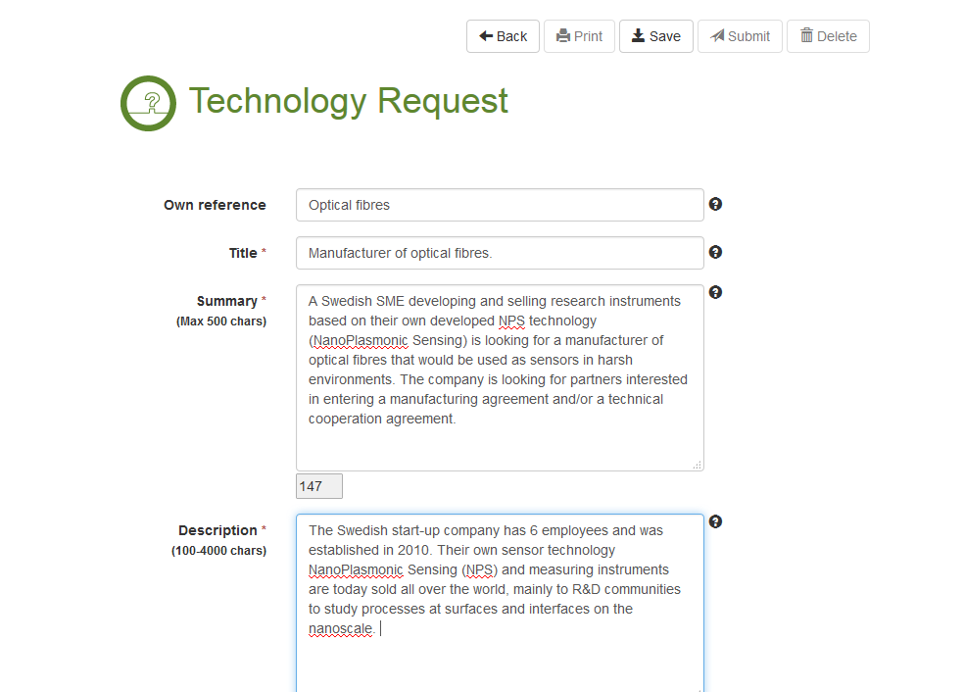
Write a first draft

Slide 6
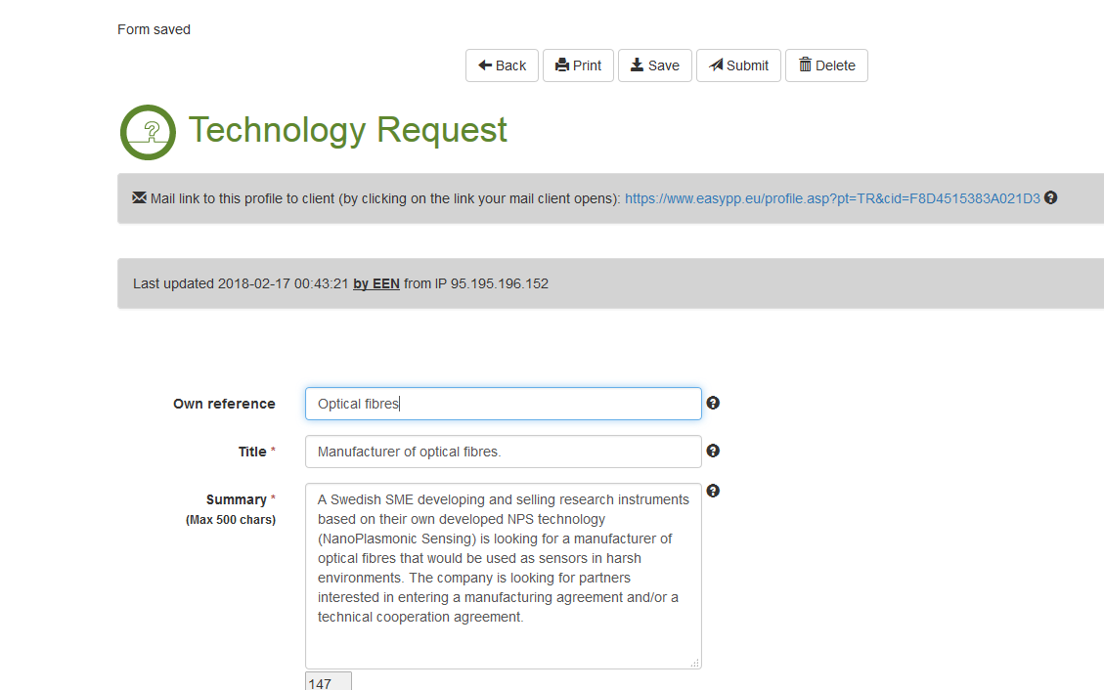
Send link to client

Slide 7
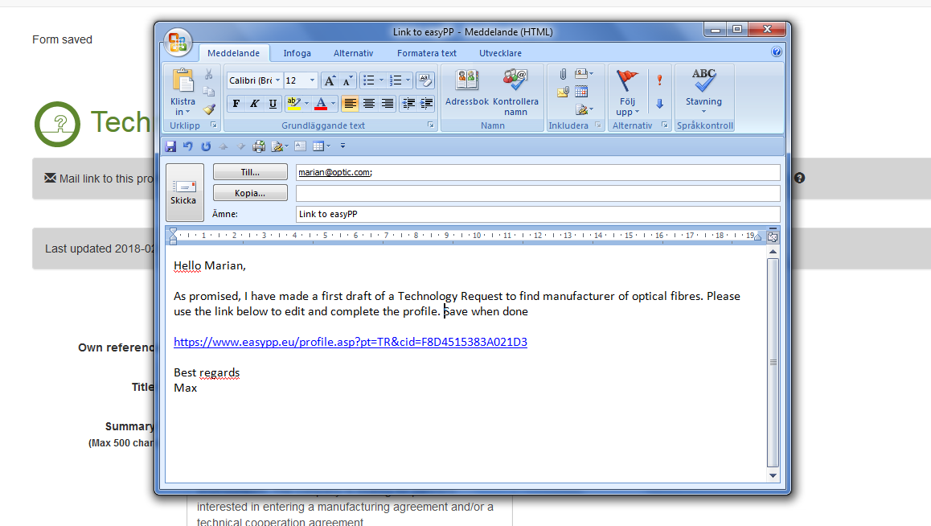
Send link to client

Slide 8
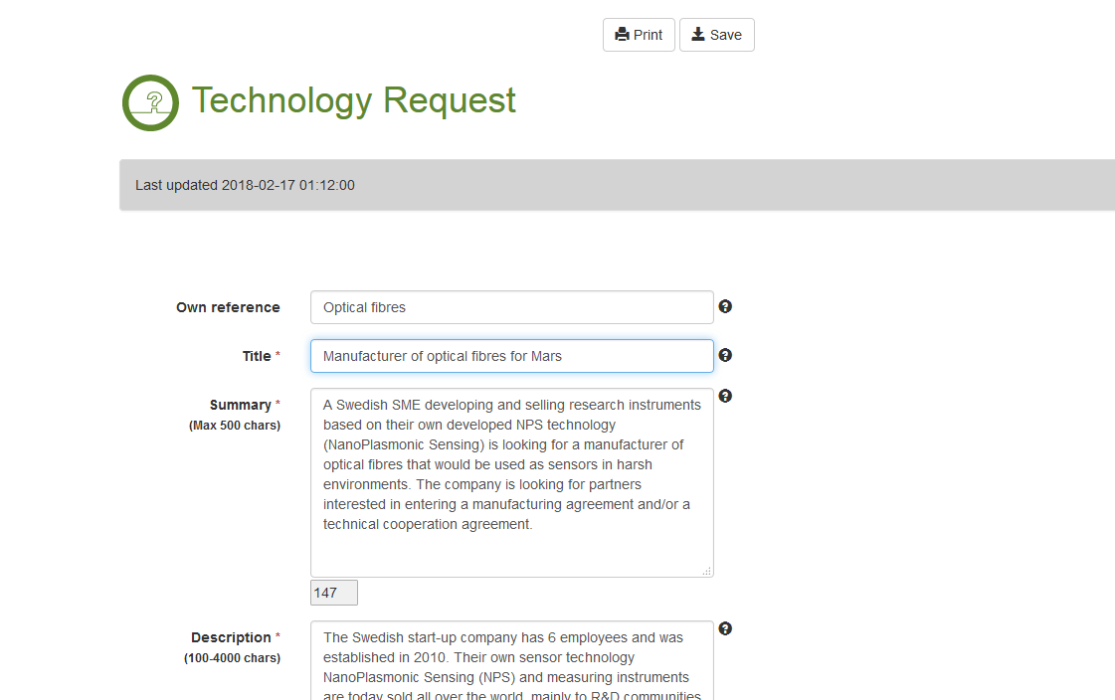
Client’s view for editing

Slide 9
Back to our view

Slide 10
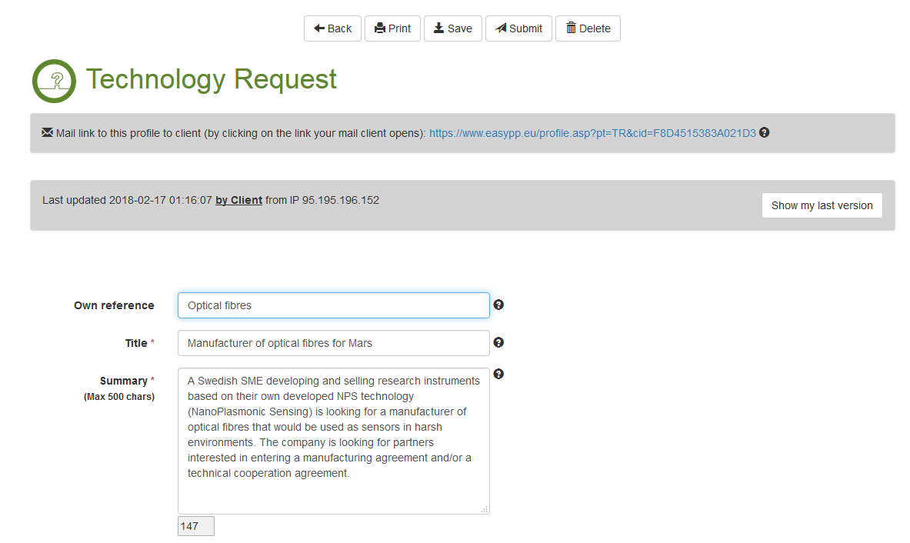
Check if client made any changes

Slide 11
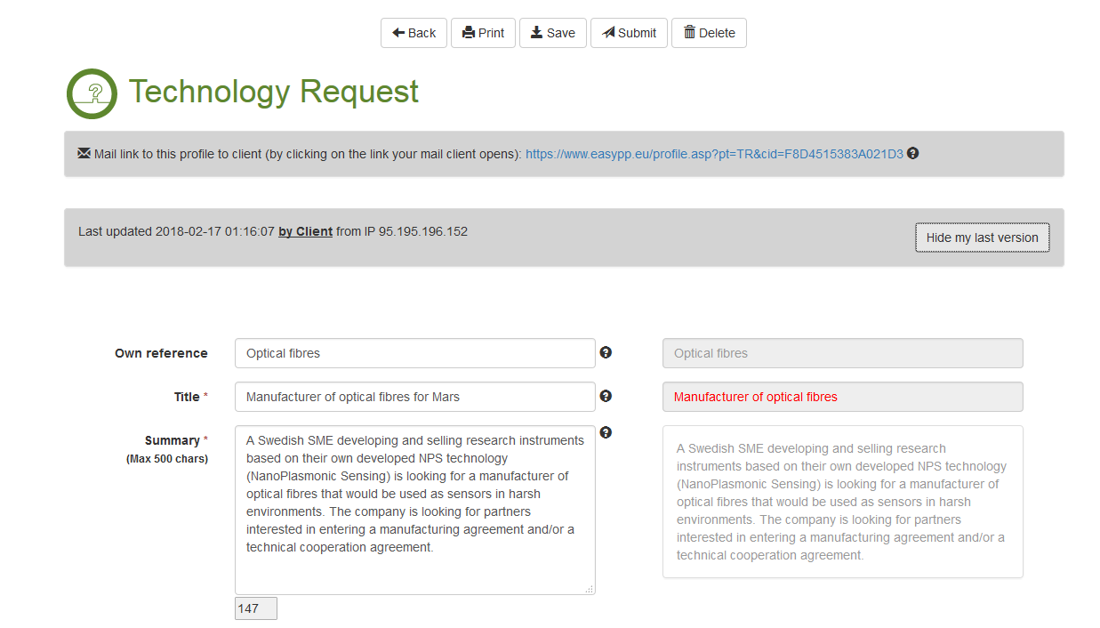
Check if client made any changes

Slide 12
Submit the profile to Merlin
O Submit for internal review
O Submit draft

Slide 14
EasyEOI
Manage your EOIs received
Edit and send them to your clients
Update interest and collaboration status

Slide 15
Login: www.EasyPP.eu

Slide 16
Go to EOIs Received

Slide 17
Select or add one of your profiles

Slide 18
Your view of EOIs received – select edit

Slide 19
Your view of the EOI with link to Merlin
Aa
bb

Slide 20
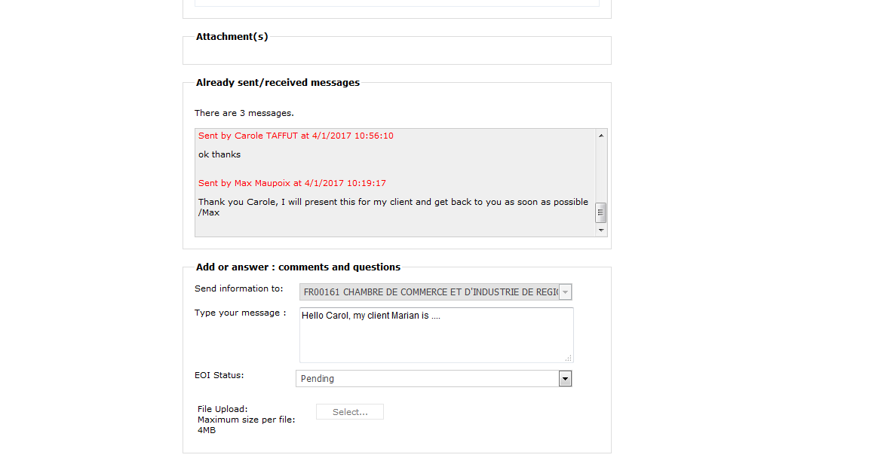
Access to the EOI on Merlin

Slide 21
Edit the EOI and save

Slide 22
Send the EOI to your client…

Slide 23
… as a link in a mail

Slide 24
Client’s view when using the link

Slide 25
Client tell us if the EOI is interesting or not

Slide 26
Thank you note to client when saved

Slide 27
Our view, we notice that client is interested

Slide 28
You can add a new EOI to the list, e.g. received by mail (and not from the POD)

Slide 29
You can also send a status summary
of all EOIs to your client …

Slide 30
… as a link in a mail

Slide 31
Thank you!
Questions:
max.maupoix@ri.se
Join the EEN IMT LinkedIn group for updates https://www.linkedin.com/groups/8190241

